Slide 1
Chapter 3 Algorithms
Section 3.3 : Complexity of Algorithms

Slide 2
Complexity of Algorithms
Few Questions
When does an algorithm provide a satisfactory solution to a problem?
First, it must always produce the correct answer.
Second, it should be efficient.
How can the efficiency of an algorithm be analyzed?
One measure of efficiency is the time used by a computer to solve a problem using the algorithm.
A second measure is the amount of computer memory required to implement the algorithm when input values are of a specified size.

Slide 3
Complexity of Algorithms (Contd.)
Questions such as these involve the computational complexity of the algorithm.
An analysis of the time required to solve a problem of a particular size involves the time complexity of the algorithm.
An analysis of the computer memory required involves the space complexity of the algorithm.
Why study complexity of algorithm?
It is obviously important to know whether an algorithm will produce an answer in a microsecond, a minute, or a billion years. Hence, we need to take time complexity into account.
Likewise, the required memory must be available to solve a problem, meaning, space complexity must be taken into account.
We will focus on time complexity in this course.

Slide 4
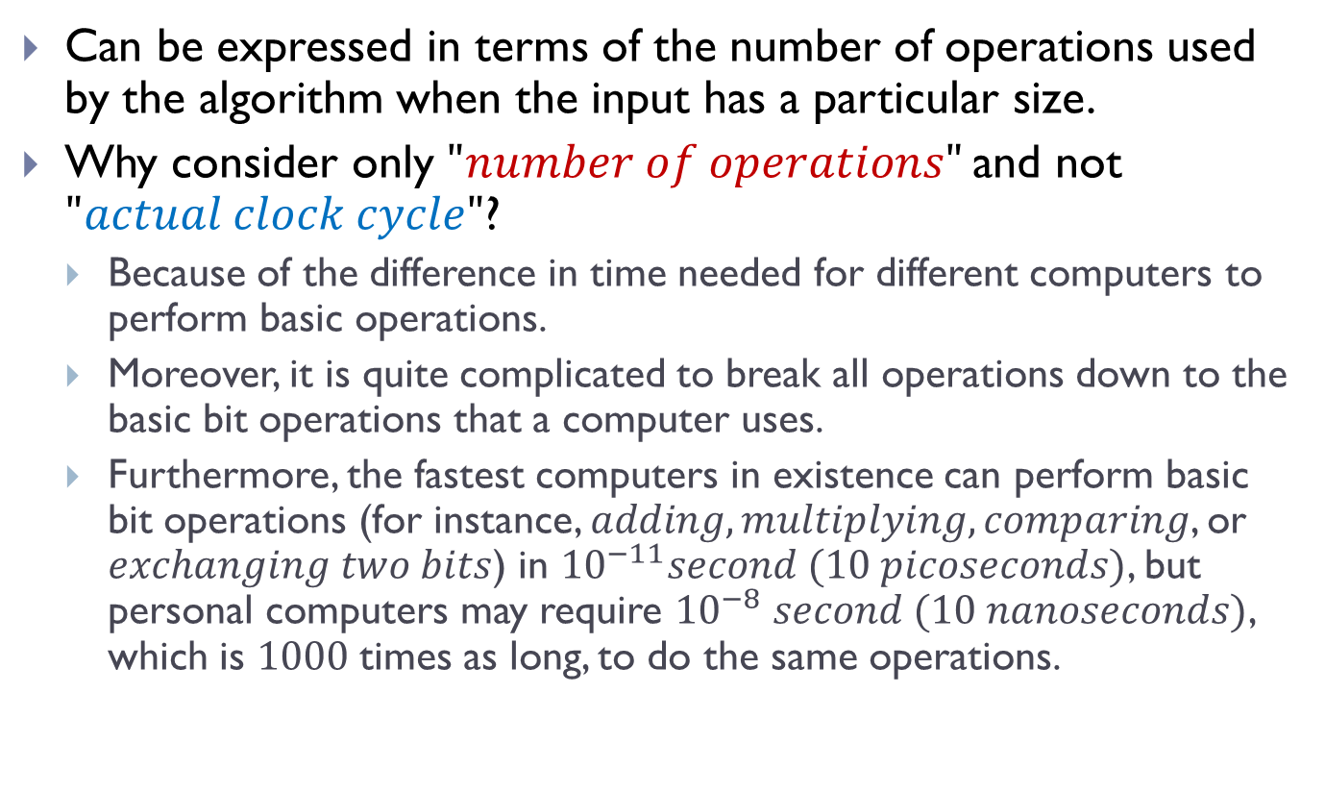
Time Complexity
Can be expressed in terms of the number of operations used by the algorithm when the input has a particular size.
Why consider only $"number of operations"$and not $"actual clock cycle"$?
Because of the difference in time needed for different computers to perform basic operations.
Moreover, it is quite complicated to break all operations down to the basic bit operations that a computer uses.
Furthermore, the fastest computers in existence can perform basic bit operations (for instance, $adding, multiplying, comparing$, or $exchanging two bits$) in ${10}^{−11}second (10 picoseconds)$, but personal computers may require ${10}^{−8} second (10 nanoseconds)$, which is $1000$times as long, to do the same operations.

Slide 5

Time Complexity (Contd.)
MEANWHILE CPU ….
Sometimes it’s obvious who the THIRD WHEEL is….
ALL IS WELL….

Slide 6
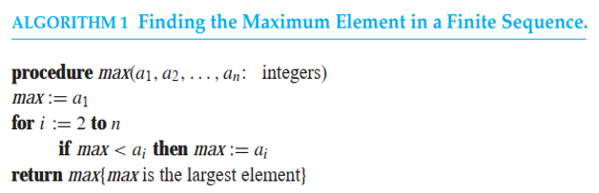
Time Complexity of Algorithms
Example 1:
Describe the time complexity of the Algorithm for finding the maximum element in a finite set of integers.

Slide 7
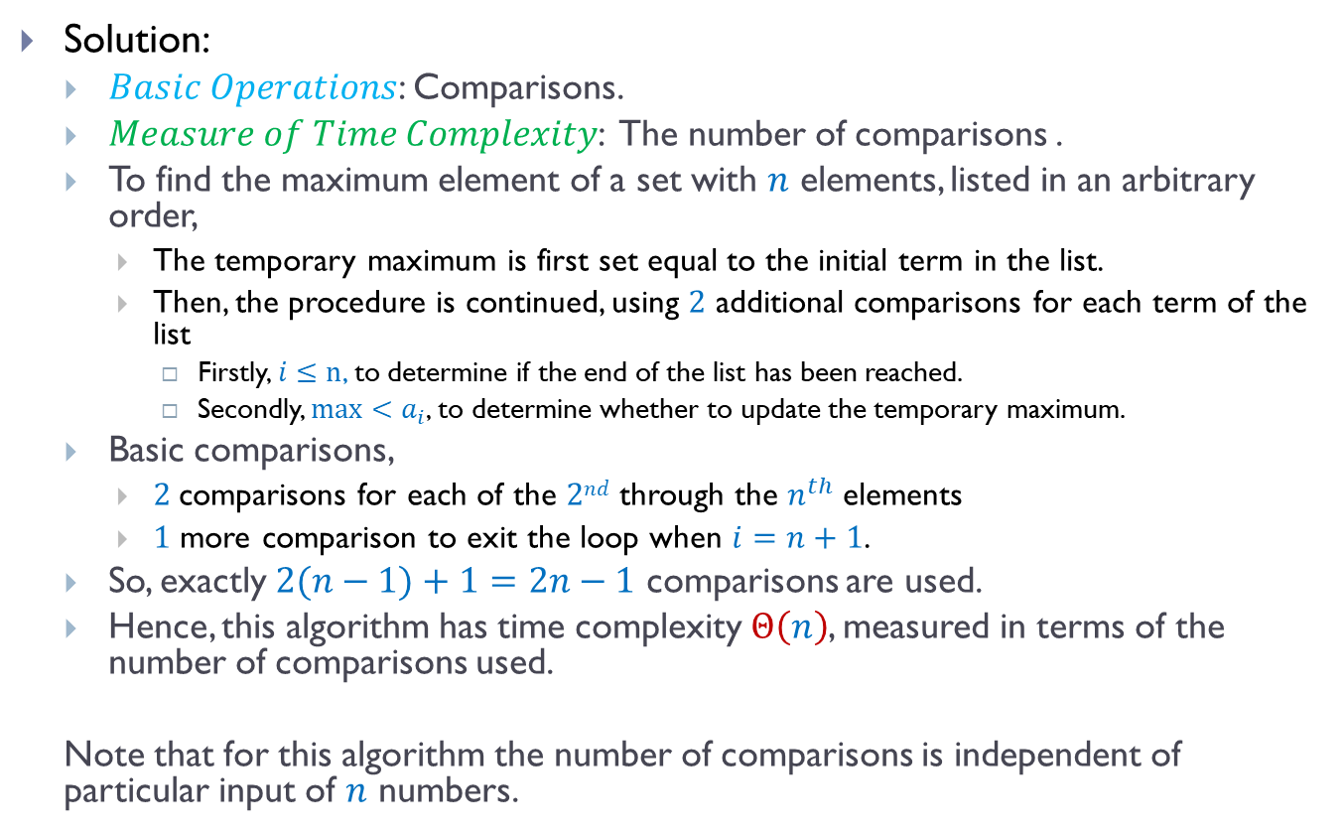
Time Complexity of Algorithms (Contd.)
Solution:
$Basic Operations$: Comparisons.
$Measure of Time Complexity$: The number of comparisons .
To find the maximum element of a set with $n$ elements, listed in an arbitrary order,
The temporary maximum is first set equal to the initial term in the list.
Then, the procedure is continued, using $2$ additional comparisons for each term of the list
Firstly, $i≤n$, to determine if the end of the list has been reached.
Secondly, $max<a_{i}$, to determine whether to update the temporary maximum.
Basic comparisons,
$2$comparisons for each of the $2nd$ through the $n^{th}$ elements
$1$ more comparison to exit the loop when $i=n+1$.
So, exactly $2(n−1)+1=2n−1$ comparisons are used.
Hence, this algorithm has time complexity $Θ\left(n\right)$, measured in terms of the number of comparisons used.
Note that for this algorithm the number of comparisons is independent of particular input of $n$ numbers.

Slide 8
Time Complexity of Algorithms (Contd.)
Worst-Case Complexity:
Worst-case analysis tells us the largest number of operations an algorithm requires to guarantee that it will produce a solution.
Average-Case Complexity:
Average-case analysis tells us the number of operations used to solve a problem over all possible inputs of a given size.
Usually much more complicated than worst-case analysis.

Slide 9
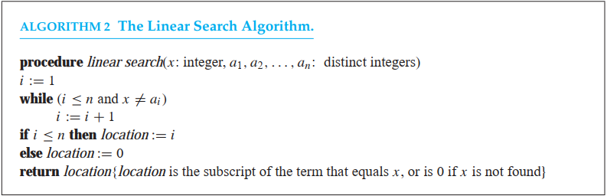
Time Complexity of Algorithms (Contd.)
Example 2:
Describe the time complexity of the linear search algorithm

Slide 10
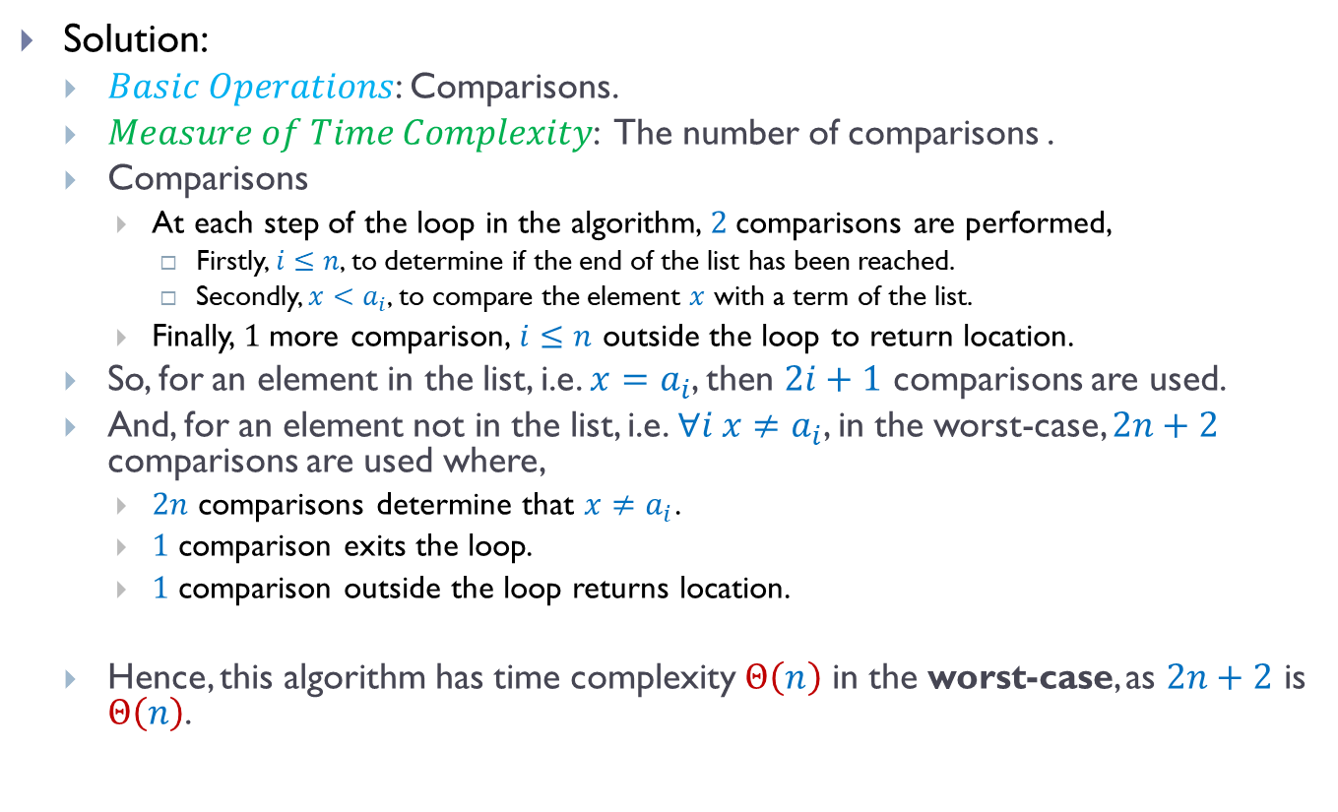
Time Complexity of Algorithms (Contd.)
Solution:
$Basic Operations$: Comparisons.
$Measure of Time Complexity$: The number of comparisons .
Comparisons
At each step of the loop in the algorithm, $2$comparisons are performed,
Firstly, $i≤n$, to determine if the end of the list has been reached.
Secondly, $x<a_{i}$, to compare the element $x$ with a term of the list.
Finally, $1$more comparison, $i≤n$ outside the loop to return location.
So, for an element in the list, i.e. $x=a_{i}$, then $2i+1$ comparisons are used.
And, for an element not in the list, i.e. $∀i x≠a_{i}$, in the worst-case, $2n+2$ comparisons are used where,
$2n$ comparisons determine that $x≠a_{i}$.
$1$ comparison exits the loop.
$1$ comparison outside the loop returns location.
Hence, this algorithm has time complexity $Θ\left(n\right)$ in the worst-case, as $2n+2$ is $Θ\left(n\right)$.

Slide 11

Time Complexity of Algorithms (Contd.)
Example 3:
Describe the average-case performance of the linear search algorithm in terms of the average number of comparisons used, assuming that the integer $x$ is in the list and it is equally likely that $x$ is in any position.

Slide 12
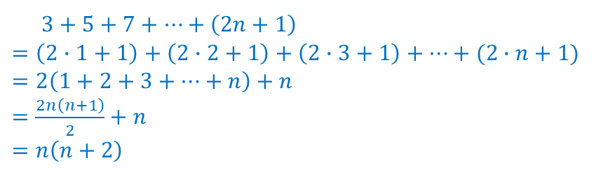
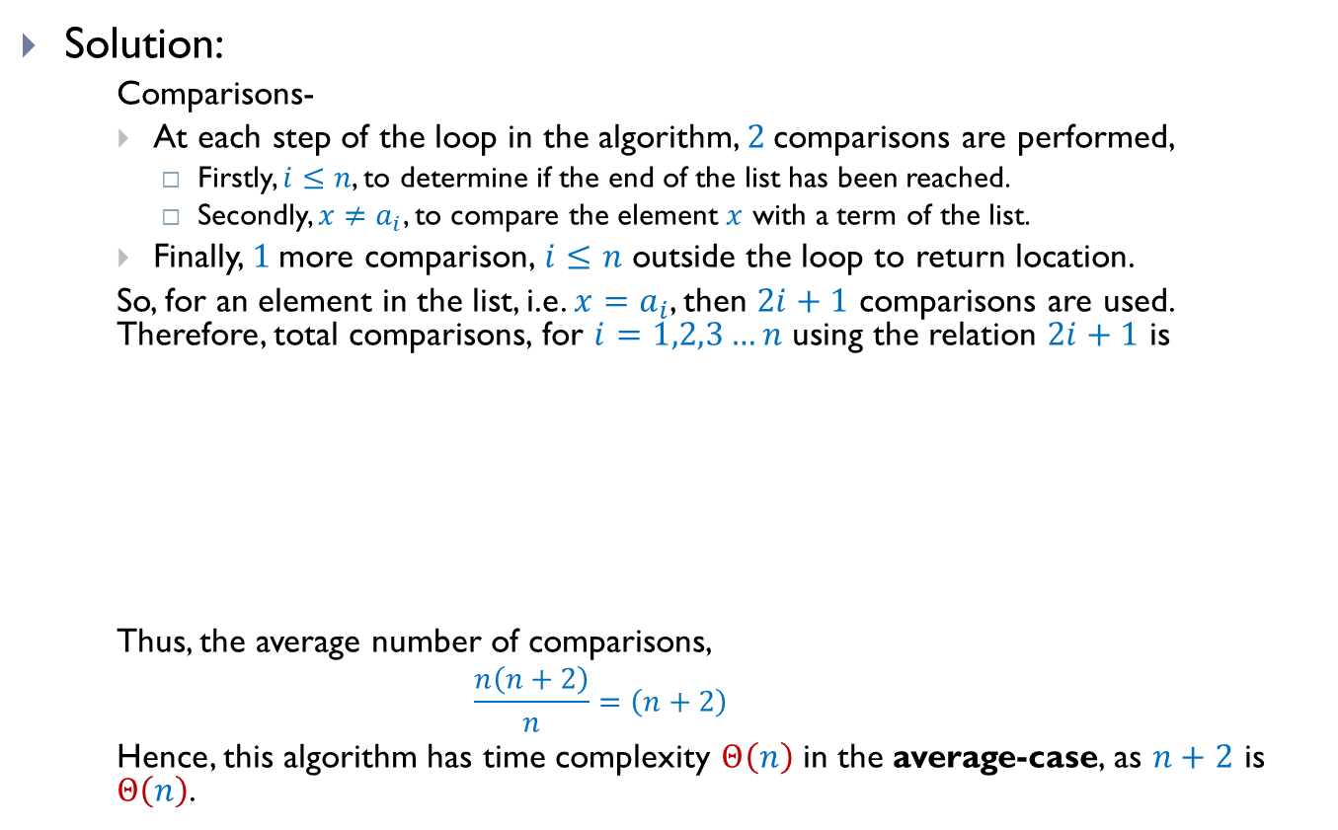
Time Complexity of Algorithms (Contd.)
Solution:
Comparisons-
At each step of the loop in the algorithm, $2$comparisons are performed,
Firstly, $i≤n$, to determine if the end of the list has been reached.
Secondly, $x≠a_{i}$, to compare the element $x$ with a term of the list.
Finally, $1$more comparison, $i≤n$ outside the loop to return location.
So, for an element in the list, i.e. $x=a_{i}$, then $2i+1$ comparisons are used. Therefore, total comparisons, for $i=1,2,3…n$ using the relation $2i+1$ is
Thus, the average number of comparisons,
$$\frac{n\left(n+2\right)}{n}=\left(n+2\right)$$
Hence, this algorithm has time complexity $Θ\left(n\right)$ in the average-case, as $n+2$ is $Θ\left(n\right)$.
$3+5+7+…+\left(2n+1\right)$ $=\left(2∙1+1\right)+\left(2∙2+1\right)+\left(2∙3+1\right)+…+(2∙n+1)$ $=2\left(1+2+3+…+n\right)+n$ $=\frac{2n\left(n+1\right)}{2}+n$ $=n\left(n+2\right)$

Slide 13
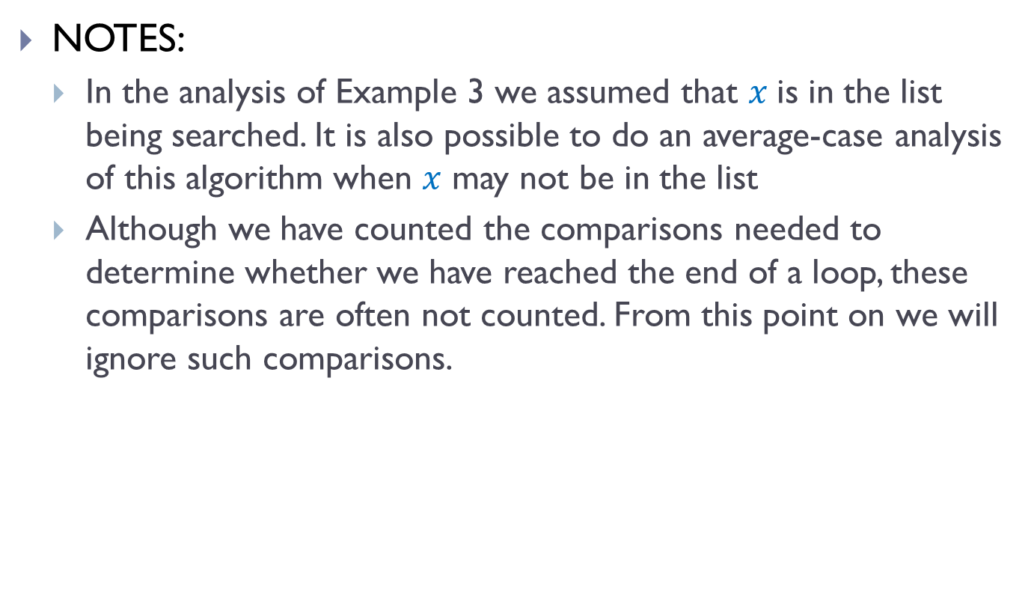
Time Complexity of Algorithms (Contd.)
NOTES:
In the analysis of Example 3 we assumed that $x$is in the list being searched. It is also possible to do an average-case analysis of this algorithm when $x$ may not be in the list
Although we have counted the comparisons needed to determine whether we have reached the end of a loop, these comparisons are often not counted. From this point on we will ignore such comparisons.

Slide 14
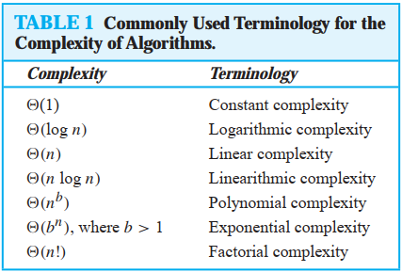
Algorithmic Paradigms
Commonly used terminologies

Slide 15
Algorithmic Paradigms (Contd.)
Brute Force Algorithm:
An important, and basic, algorithmic paradigm.
A problem is solved in the most straightforward manner based on the statement of the problem and the definitions of terms.
Designed to solve problems without regard to the computing resources required.
Although often inefficient, are often quite useful.
Tractable:
A problem that is solvable using an algorithm with polynomial worst-case complexity, because the expectation is that the algorithm will produce the solution to the problem for reasonably sized input in a relatively short time.

Slide 16
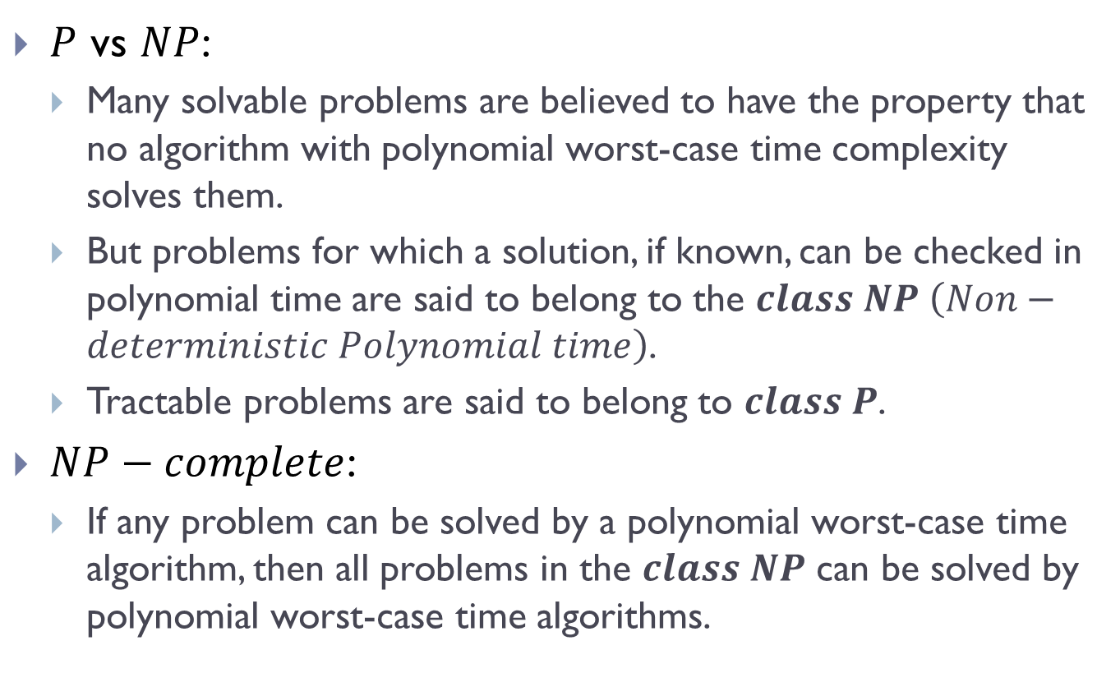
Algorithmic Paradigms (Contd.)
$P$ vs $NP$:
Many solvable problems are believed to have the property that no algorithm with polynomial worst-case time complexity solves them.
But problems for which a solution, if known, can be checked in polynomial time are said to belong to the $class NP \left(Non−deterministic Polynomial time\right)$.
Tractable problems are said to belong to $class P$.
$NP−complete$:
If any problem can be solved by a polynomial worst-case time algorithm, then all problems in the $class NP$ can be solved by polynomial worst-case time algorithms.

Slide 17
THE END

